Slide 1
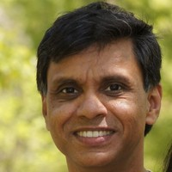
What is a page table?
And why should we care about it?
Khalid Aziz
Senior Software Engineer,
Oracle

